Slide 1

SENSORS

Slide 2
TOPICS TO BE DISCUSSED
Definition of sensors
Classification of sensors
Necessity of sensors for robots
Sensors in a robot

Slide 3
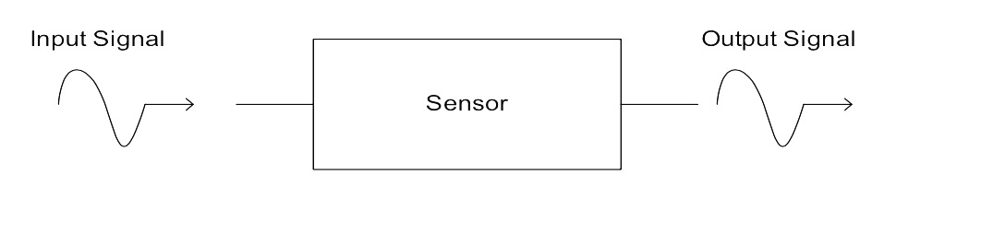
DEFINITION
According to ANSI, sensor is defined as "A device which provides usable output in response to a specified measurand ".

Slide 4
MEASURANDS – Quantities intended to be sensed
Motion
Position
Force
Pressure
Flow
Radiation
Sound
Moisture
Temperature
Chemical presence
Light

Slide 5
OUTPUT GIVEN BY THE SENSORS
Generally output is an electric signal which can be channeled, amplified and modified as per the requirement of user.
Ex:-voltage, current, charge etc.,

Slide 6
CLASSIFICATION OF SENSORS
Primarily, sensors are classified on the following basis
How do they sense?
What do they sense?

Slide 7
HOW DO THEY SENSE?
Active sensors
send signal into environment and measure the interaction of signal with environment.
Ex:- radar, sonar
Passive sensors
record signals already present in the environment.
Ex:- video cameras

Slide 8
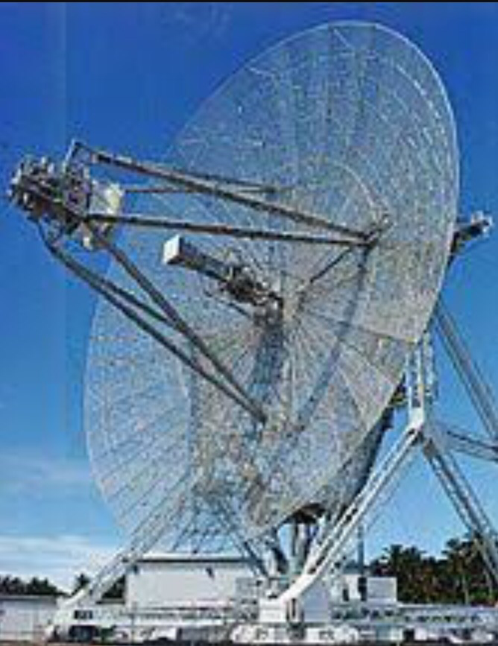
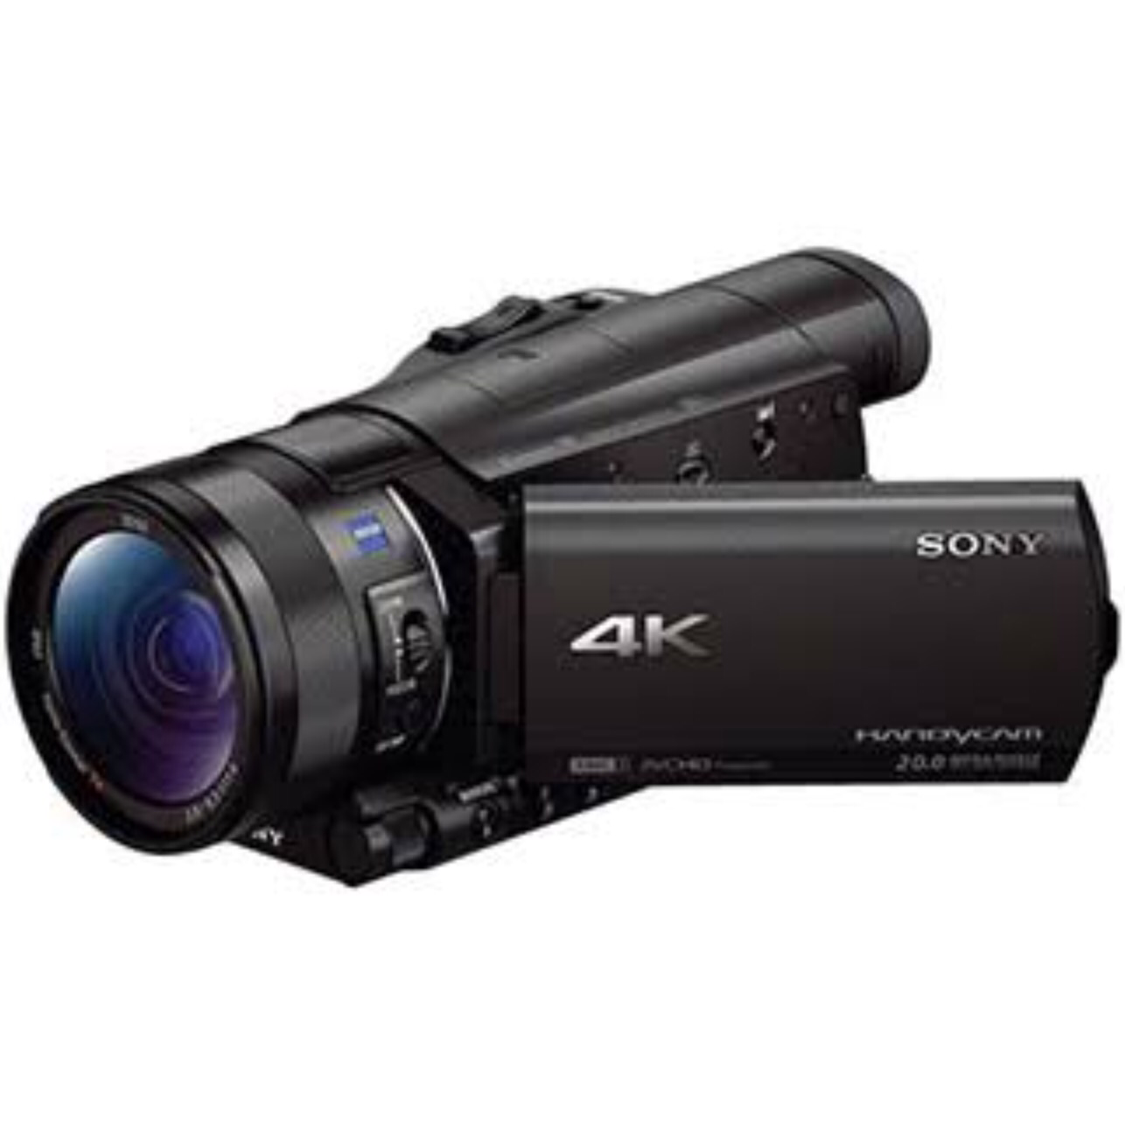
Radar Camera

Slide 9
WHAT DO THEY SENSE?
Exteroceptive
Proprioceptive
Interoceptive
These form the major parts for a robot.

Slide 10
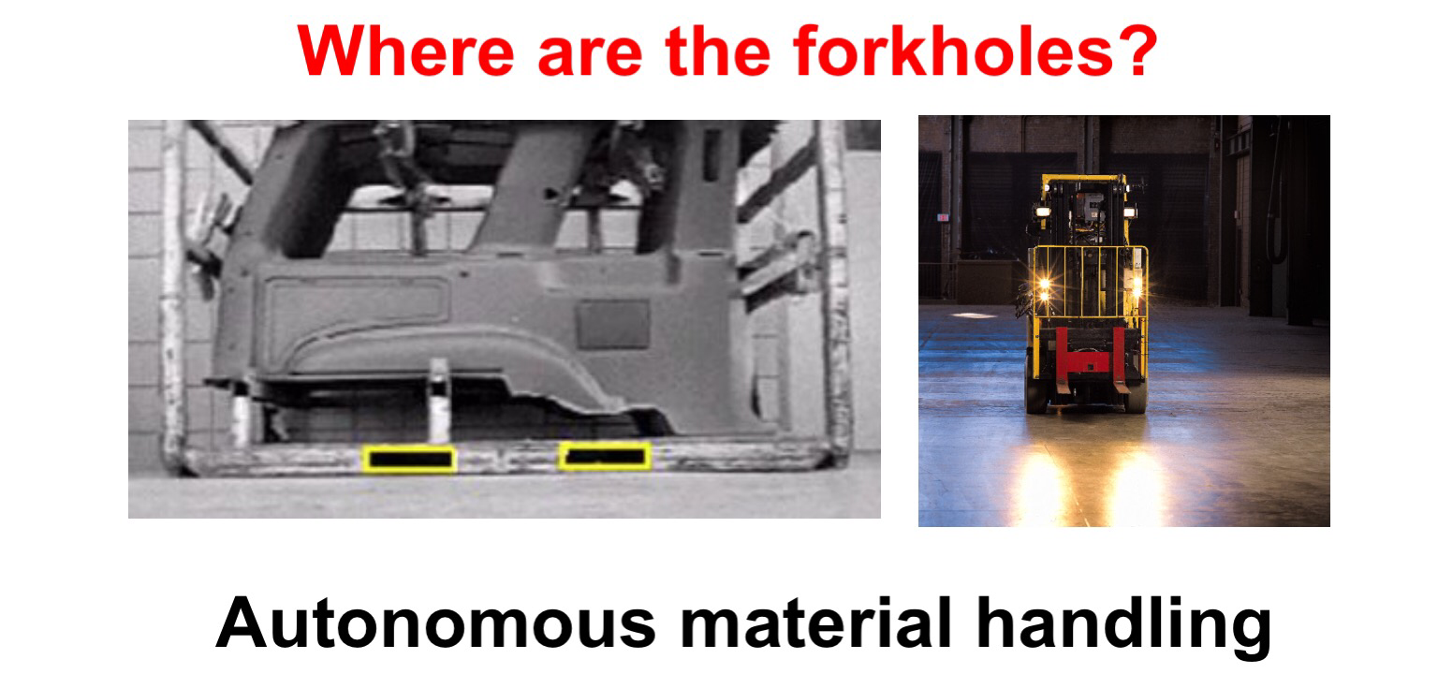
EXTEROCEPTIVE SENSORS
Deal with external world.
Measures parameters external to the system.

Slide 11
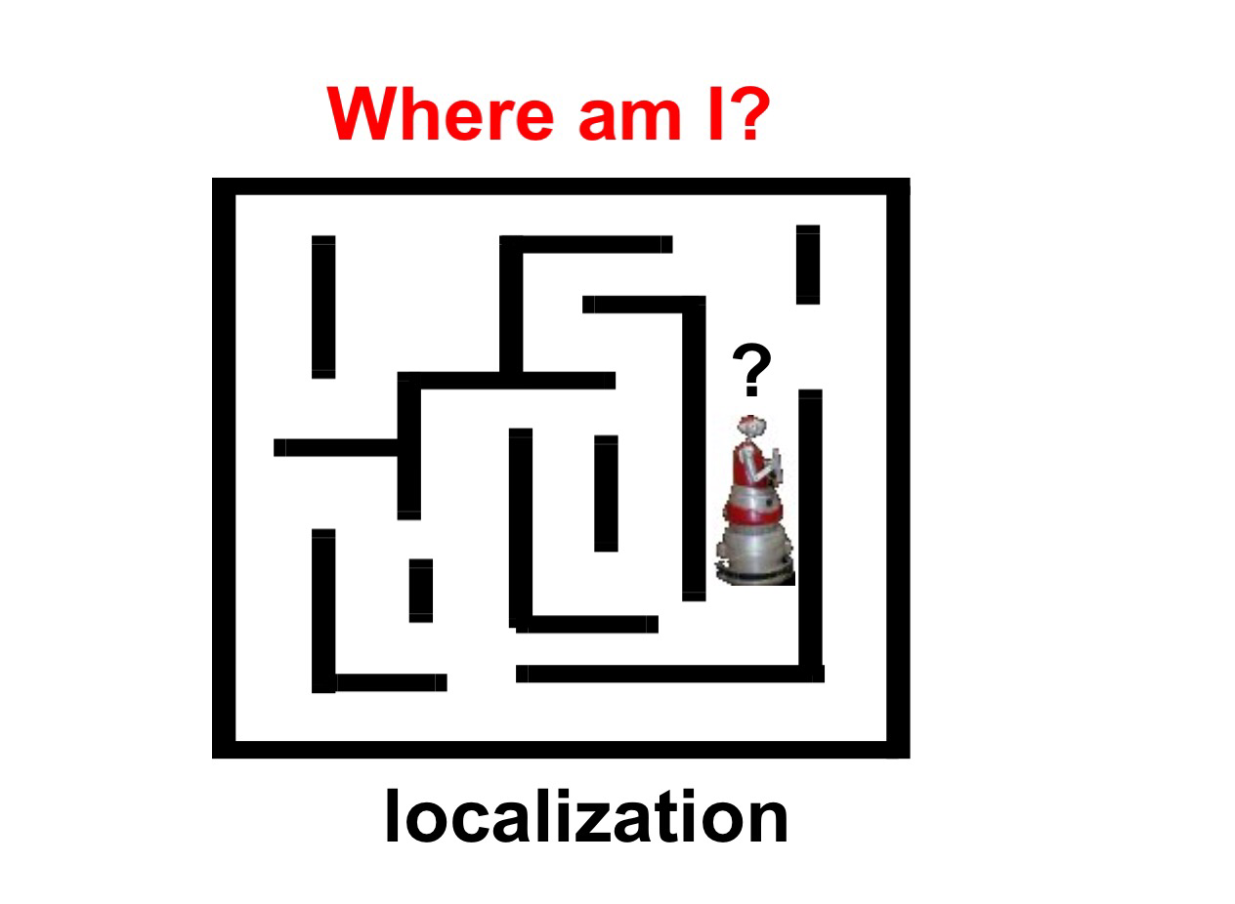
PROPRIOCEPTIVE SENSORS
Deal with itself
Measures robotic interaction with environment.
Ex:- GPS

Slide 12
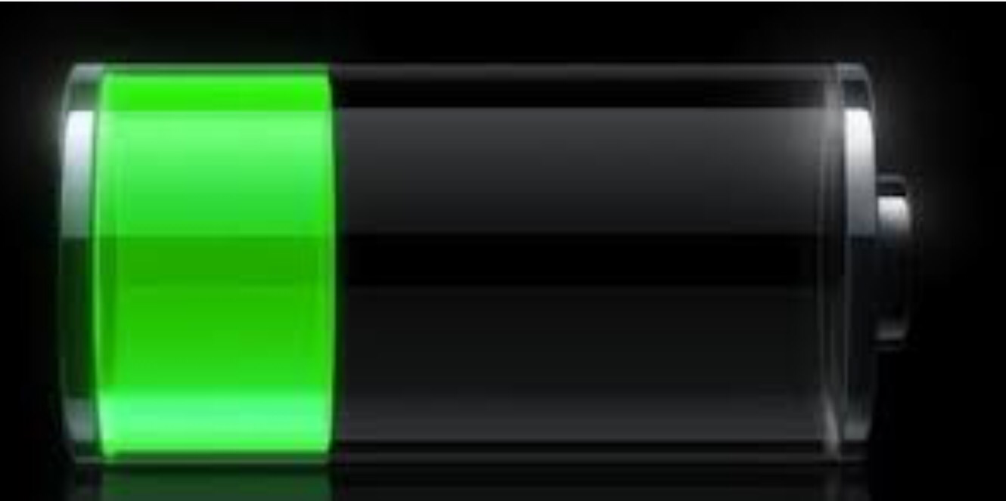
INTEROCEPTIVE SENSORS
Measures internal data of the system
Ex:- battery charge state

Slide 13
CHARACTERISTICS OF GOOD SENSORS
High sensitivity
High resolution
Accuracy & precision
Less power consumption
Less noise and disturbance

Slide 14
WHY DO ROBOTS NEED SENSORS?
Robots must know: Where am I? What is my goal? What are my obstacles?
Sensors provides awareness of the surroundings.
Allows the interaction of robot with environment.
Protects and gives the robot capability to achieve their goals.

Slide 15
SENSORS IN A ROBOT
Robots use
Cameras for eyes
Microphones for ears
GPS for location
Radars to find obstacles
Infrared sensors to detect heat
Touch sensors for touch

Slide 16

THANK YOU

